Slide 1
Scheduling System Analysis Model Taylor Mathews Stephen George Michael Deluca Chase Laprime

Slide 2
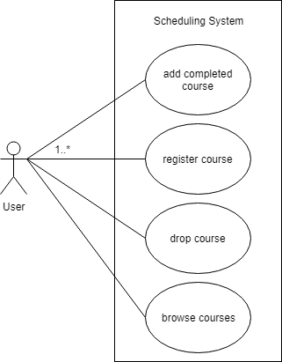
Use Case Diagram

Slide 3
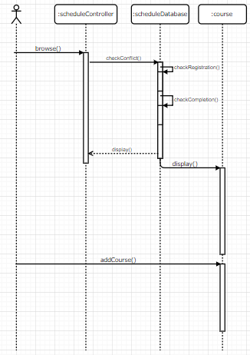
Sequence Diagram

Slide 4
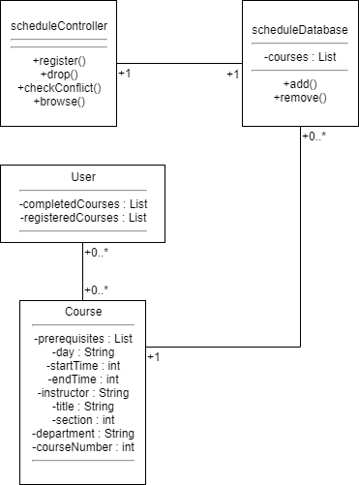
Class Diagram

Slide 5
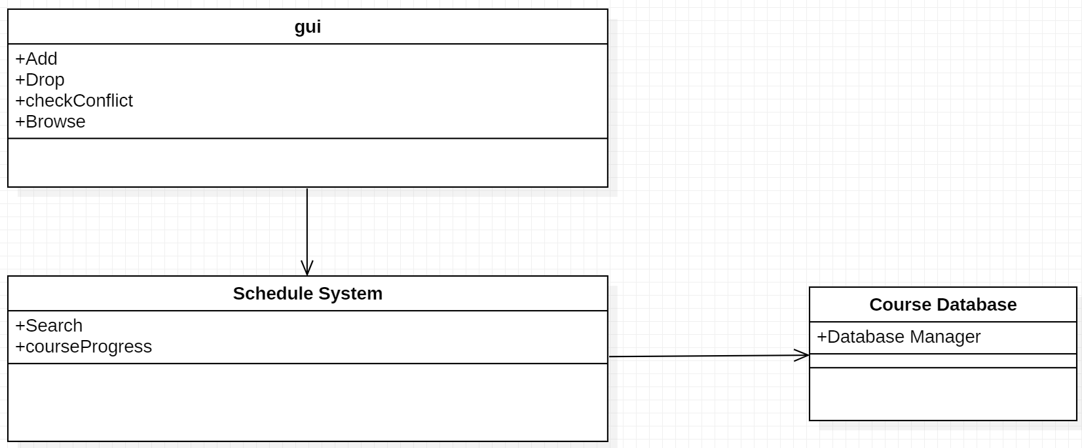
Architecture Diagram

